Slide 1
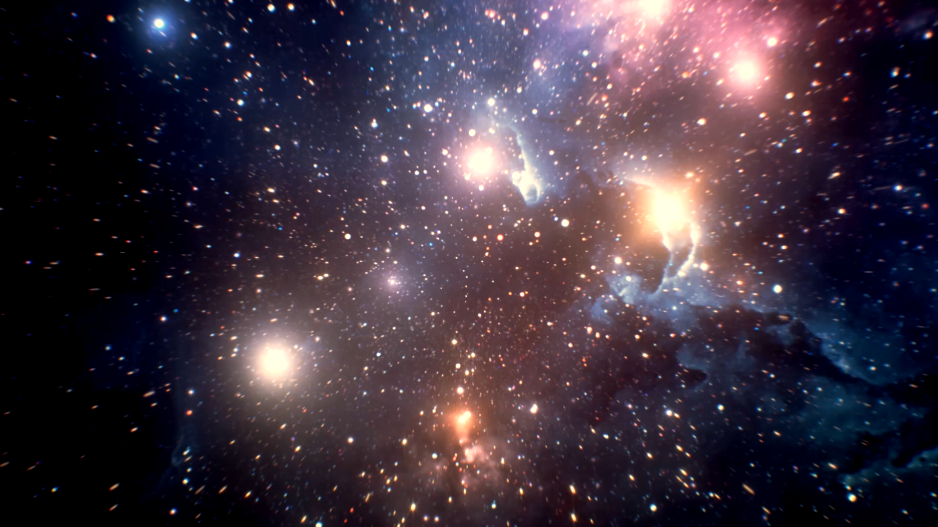
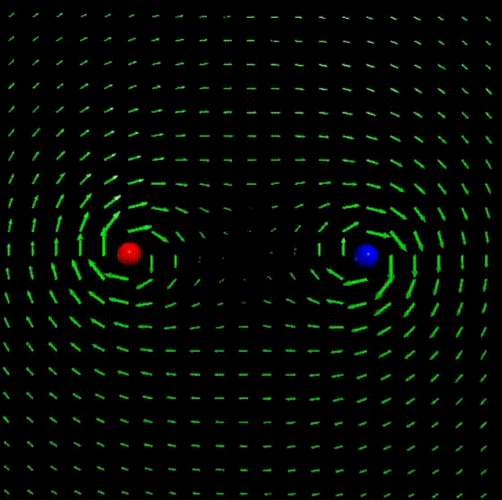
Teleparallel Gravity Relativistic Gravity in Flat Spacetime
Presentation by Ayush Aggarwal & David Kagan

Slide 2

Abstract
This presentation reviews the mathematical and conceptual framework of Teleparallel Gravity, a theory of gravity that is equivalent to General Relativity.
We explore the distinctions between changes of reference frame versus changes of coordinates
Illustrate these ideas using a visual model based on stereographic projection.

Slide 3
Introduction
Teleparallel Gravity: An equivalent formulation to General Relativity.
Encodes gravity in terms of torsion, not curvature.
Describes spacetime as flat (Minkowski), with torsion capturing gravitational effects.
Provides an alternative, field-theoretic perspective on gravity.

Slide 4
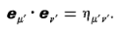
Tetrads
An infinitesimal version Of a coordinate system is supplied by a "tetrad," or "moving frame“
A tetrad (or vierbein) consists of a set of four basis vectors e^{α}. These vectors form a local frame of reference.
The zeroth basis vector is the 4-velocity of the observer.
The tetrad vectors are chosen to be orthogonal and of unit magnitude. This means that in the local frame
Tetrads provide a local reference frame at each point in spacetime, allowing us to translate between coordinate-based descriptions and local, flat Minkowski space.
Hence, they are coordinate-independent.
“Gravitation" by Charles Messner
“Gravitation" by Charles Misner

Slide 5
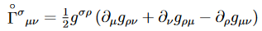
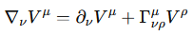
Levi-Civita Connection
The Levi-Civita connection is used in General Relativity
g_{ρν}​ is the metric tensor
g^{σρ} is the inverse metric tensor
For a vector field , and its covariant derivative
"An Introduction to Teleparallel Gravity" by Aldrovandi and Pereira
“Gravitation" by Charles Misner

Slide 6
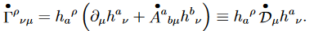
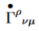
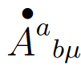
Weitzenböck Connection
In TEGR the Weitzenböck connection is used instead of the Levi-Civita connection
: frame field or tetrad
: Weitzenböck connection
: Spin connection components. This term adjusts the basis vectors in the local frame to account for torsion.
Describes how tetrad vectors change in a torsion-based framework
"An Introduction to Teleparallel Gravity" by Aldrovandi and Pereira

Slide 7
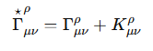
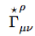
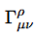
Connecting Levi-Civita and Weitzenböck Connections : Contortion Tensor
The contortion tensor ​ quantifies the difference between the Levi-Civita connection and the Weitzenböck connection. It effectively measures how much torsion deviates from the purely curvature-based description of spacetime.
: Weitzenböck connection, includes torsion effects.
​: Levi-Civita connection, includes curvature effects.
​: Contortion tensor, quantifies the difference due to torsion.
"An Introduction to Teleparallel Gravity" by Aldrovandi and Pereira

Slide 8
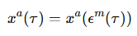
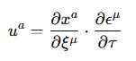
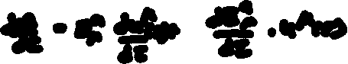

Transforming Coordinates
Arbitrary transform for coordinates:
Speed:

Slide 9
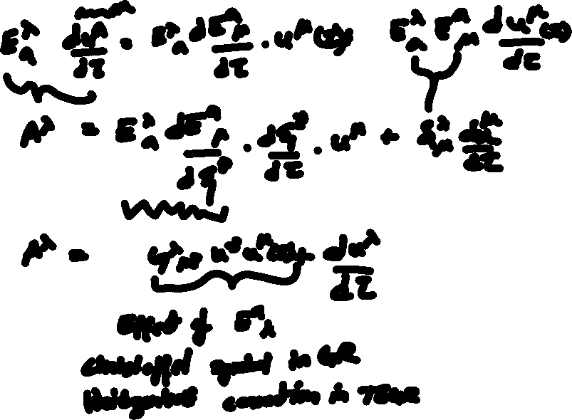

Slide 10
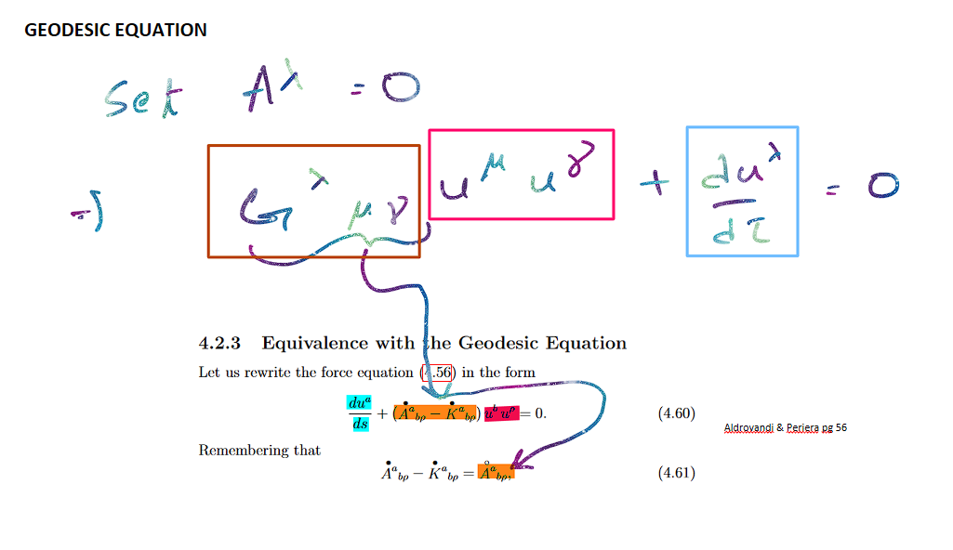

Slide 11
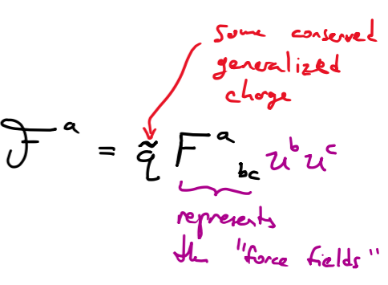
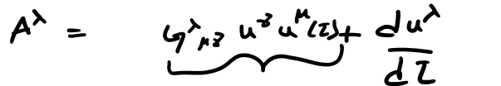
Field Like Formulation
If we attempt to formulate a force field that mimcs the arbitrary coordinate transform we saw earlier
This forces q = mass, as the above is the acceleration.

Slide 12
Distinction Between Changes of Coordinates and Reference Frames
In Teleparallel Gravity (TEGR), this distinction is accounted for by the Weitzenböck connection.
The torsion effects in TEGR mimic the additional terms that arise when using non-inertial frames.
By distinguishing between coordinate changes and reference frame shifts, TEGR provides an alternative formulation where gravity appears as a force-like field, similar to electromagnetism, with torsion playing a key role.

Slide 13
References
An Introduction to Teleparallel Gravity
R. Aldrovandi and J. G. Pereira, An Introduction to Teleparallel Gravity. Springer, 2013.
Gravitation
C. W. Misner, K. S. Thorne, and J. A. Wheeler, Gravitation. W. H. Freeman, 1973.
The Teleparallel Equivalent of General Relativity
J. W. Maluf, "The Teleparallel Equivalent of General Relativity," Annalen der Physik, vol. 525, no. 5, pp. 339-357, 2013.

